Slide 1
Approximation algorithms 2 TSP, k-Center, Knapsack
CS240 Spring 2023
Rui Fan

Slide 2
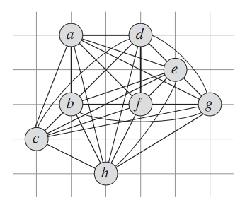
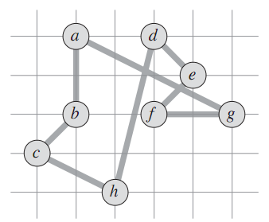
Traveling Salesman Problem
Input A complete graph with weights on the edges.
Output A cycle that visits each city once.
Goal Find a cycle with minimum total weight.
source: CLRS

Slide 3
Metric TSP
TSP is NP-hard. In fact, it’s even NP-hard to approximate when weights can be arbitrary.
However, TSP is approximable for special types of weights.
A weighted graph satisfies the triangle inequality if for any 3 vertices p, q, r, we have d_{pq}+d_{qr} ≥ d_{pr}.
I.e., direct path is always no worse than a roundabout path.
This is called a metric TSP.
There is a 1.5-approx algorithm for TSP in graphs with the triangle inequality.
Let’s look at a simpler 2-approx first.
q
r
p

Slide 4
A 2-approximation for TSP
Construct a minimum spanning tree T on G.
Use depth-first traversal to visit all the vertices in T, starting from an arbitrary vertex.
Convert this depth-first traversal T’ to a cycle H that doesn’t revisit any vertex.
Return H as the TSP tour.

Slide 5
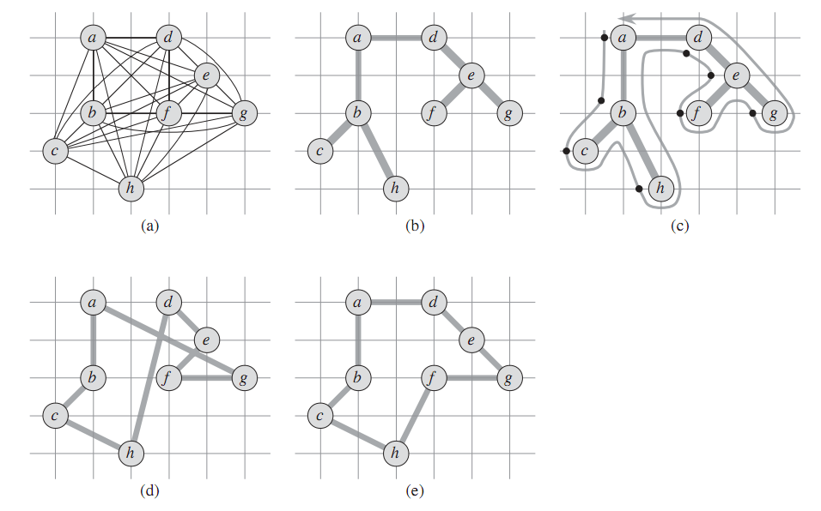
Example
source: CLRS
(b) The MST T.
(c) visit T in order abcbhbadefegeda.
(d) converts the tour from (c) to a Hamiltonian cycle, that doesn’t revisit any vertices.
(e) is the optimal TSP.

Slide 6
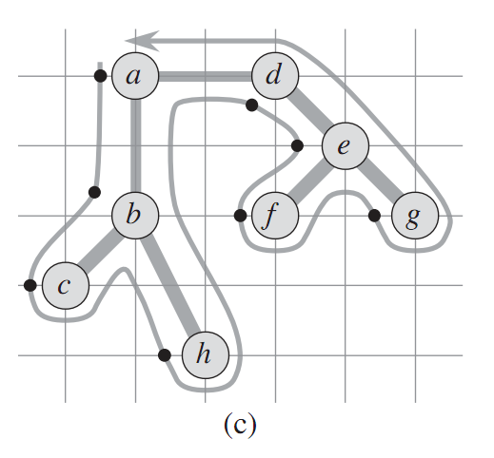
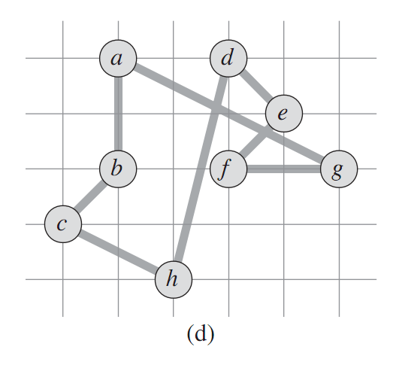
Making the tour Hamiltonian
To go from (c) to (d), we need to make a tour T’ that revisits vertices into a cycle H that doesn’t revisit vertices.
We use shortcutting.
If we revisit a vertex in T’, we directly jump to the next vertex in T’ we haven’t visited.
We allow revisiting the first vertex.
The sequence of vertices we now visit is H.
Ex abcbhbadefegeda → abchdefga.

Slide 7
Making the tour Hamiltonian
Lemma If H is the shortcut of T’, then c(H)≤c(T’).
Proof We formed H from T’ by skipping over some vertices. E.g. we directly went from c to h, skipping over b.
But by the triangle inequality, d_{cb}+d_{bh} ≥ d_{ch}.
So shortcutting from c to h didn’t increase the distance.
The same thing applies to all our shortcuts.
So H is no longer than T’.

Slide 8
Proof of 2-approximation
Let H* be an optimum TSP.
If we delete an edge from H*, we get a spanning tree.
Since T is an MST, c(T) ≤ c(H*).
Call the path from the depth-first traversal T’.
T’ crosses each edge in T twice.
So c(T’) = 2 c(T).
Let H be the outcome of shortcutting T’.
H is a Hamiltonian cycle. It visits all the vertices, and ends where it started.
c(H) ≤ c(T’), by the lemma.
c(H) ≤ c(T’) = 2 c(T) ≤ 2 c(H*).
So H is a 2-approximation.

Slide 9
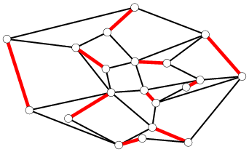
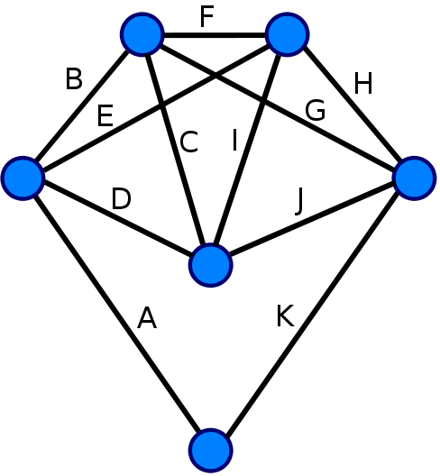
Matchings and Euler cycles
A matching in a graph is a set of nonintersecting edges.
A perfect matching is a matching that includes every vertex.
An Euler tour of a graph is a path that starts and ends at the same vertex, and visits every edge once.
Hamiltonian tour visits every vertex once.
Thm (Euler) A graph has an Euler tour if and only if all vertices have even degree.
Note how deciding if graph has Euler tour is trivial, but deciding if it has Hamiltonian tour is NPC!

Slide 10
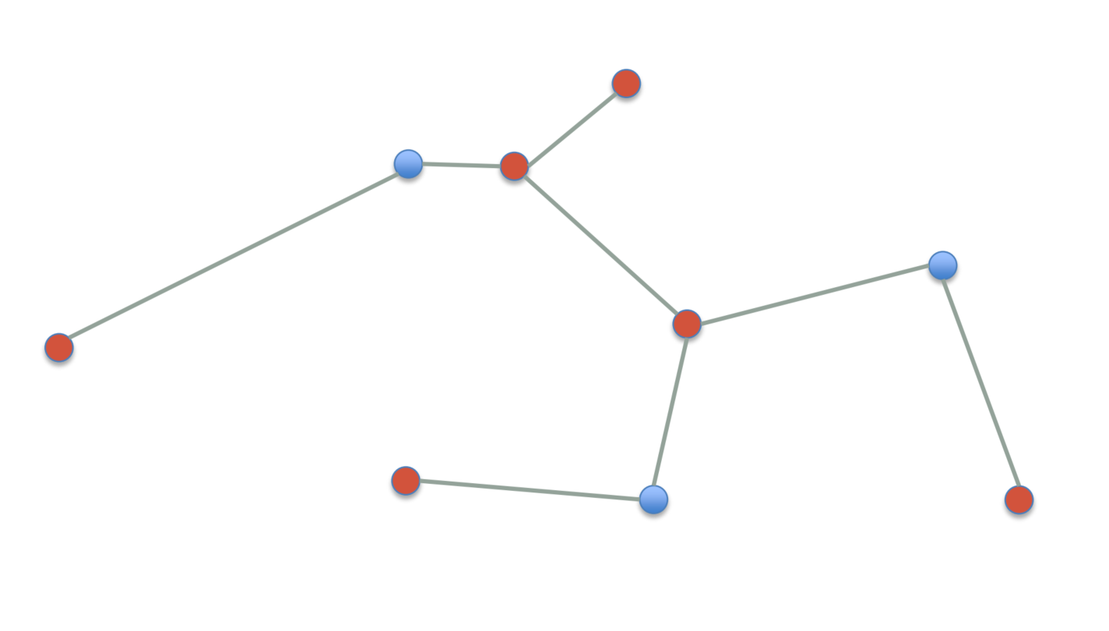
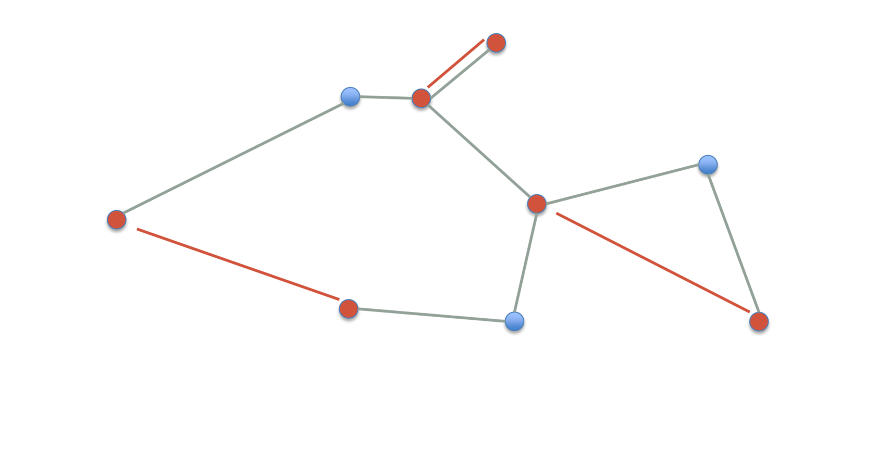
Christofides 3/2-approx algorithm
A 3/2-approximation for TSP with triangle inequality.
Construct a minimum spanning tree T on G.
Find the set V’ of odd degree vertices in T.
Construct a minimum cost perfect matching M on V’.
Add M to T to obtain T’.
Find an Euler tour T’’ in T’.
Shortcut T’’ to obtain a Hamiltonian cycle H. Output as the TSP.

Slide 11
Why Christofides works well
In the 2-approx, we found a TSP by “doubling” the MST to an Euler tour, then shortcutting.
We need to start with Euler tour before shortcutting to ensure we visit all cities.
Key to Christofides is to find a shorter Euler tour, without doubling the MST.
A graph with only even degree vertices always has Euler tour.
So we want to modify the MST to have all even degrees, by adding a matching.
Euler tour thru all edges
shortcutting
Hamiltonian tour thru all cities

Slide 12
Proof of correctness
Lemma T’ has an Euler tour.
Proof There are an even number of vertices in V’, because the total degree of T is even.
Since G is a complete graph and |V’| is even, there’s a perfect matching on V’.
The min cost perfect matching can be found in O(n²) time using the blossom algorithm.
The degree of every node in M is odd. Since V’ are the odd degree nodes in T, adding M to T makes all nodes in T’ have even degree.
T’ has Euler tour by Euler’s theorem.

Slide 13
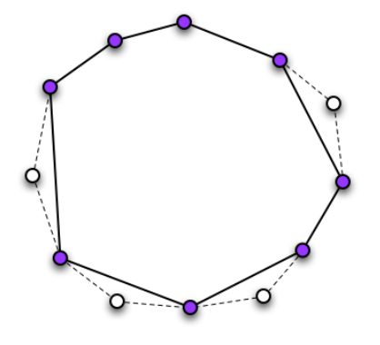
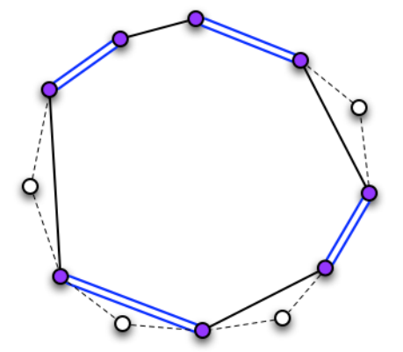
Proof of correctness
Lemma Let H* be an optimal TSP on G, and let m be the cost of M. Then m ≤ c(H*)/2.
Proof Let H’ be the optimal TSP on V’.
c(H’) ≤ c(H*) because H’ is an optimal TSP on fewer vertices.
H’ is a cycle on V’, so it consists of two matchings on V’. The cheaper one has cost m’ ≤ c(H’)/2 ≤ c(H*)/2.
m ≤ m’ because M has min cost.
http://www.mpi-inf.mpg.de/departments/d1/teaching/ss12/AdvancedGraphAlgorithms/Slides06.pdf

Slide 14
Proof of 3/2-approximation
Thm Let H be the TSP output by Christofides and let H* be an optimal TSP. Then c(H) ≤ 3/2*c(H*).
Proof
c(T) ≤ c(H*) because T is an MST.
c(T’) = c(M) + c(T) ≤ c(H*)/2 + c(H*) = 3/2*c(H*).
c(H) ≤ c(T’) because H is the shortcut of T’.
Construct a minimum spanning tree T on G.
Find set V’ of odd-degree vertices in T.
Construct a minimum cost perfect matching M on V’.
Add M to T to obtain T’.
Shortcut T’ to obtain a Hamiltonian cycle. Output as the TSP.

Slide 15





k-Center problem
Given a city with n sites, we want to build k centers to serve them.
Let S be set of sites, C be set of centers.
Each site uses the center closest to it.
Distance of site s from the nearest center is d(s,C) = min_{c∈C} d(s,c).
Goal is to make sure no site is too far from its center.
We want to minimize the max distance that any site is from its closest center.
Minimize r(C)=max_{s∈S} min_{c∈C} d(s,c).
C is called a cover of S, and r is called C’s radius.
Where should we put centers to minimize the radius?
Assume distances satisfy triangle inequality.
p
q
≤ p+q
r(C)

Slide 16
Gonzalez’s algorithm
k-Center is NP-complete.
We’ll give a simple 2-approximation for it.
Idea Say there’s one site that’s farthest away from all centers. Then it makes the radius large. We’ll put a center at that site, to reduce the radius.
Note we allow putting center at same location as site.

Slide 17
Gonzalez’s algorithm
C is set of centers, initially empty.
repeat k times
choose site s with maximum d(s,C)
add s to C
return C
Note The centers are located at the sites.

Slide 18
Proof of correctness
Let C be the algorithm’s output, and r be C’s radius.
r = max_{s∈S} min_{c∈C} d(s,c)
Lemma 1 For any c,c’∈C, d(c,c’)≥r.
Proof Since r is the radius, there exists a point s∈S at distance ≥ r from all the centers.
If there’s no such s, then C’s radius < r.
So s is distance ≥ r from c and c’.
Suppose WLOG c’ is added to C after c.
If d(c,c’)<r, then algorithm would add s to C instead of c’, since s is farther.
c
< r
c’
≥ r
≥ r
s

Slide 19
Proof of correctness
Cor There exist k+1 points mutually at distance ≥ r from each other.
By the lemma, the k centers are mutually ≥ r distance apart.
Also, there’s an s∈S at distance ≥ r from all the centers.
Otherwise C’s covering radius is < r.
So the k centers plus s are the k+1 points.
Call these k+1 points D.

Slide 20
Proof of correctness
Let C* be an optimal cover with radius r*.
Lemma 2 Suppose r > 2r*. Then for every c∈D, there exists a corresponding c’∈C*. Furthermore, all these c’ are unique.
Proof Draw a circle of radius r/2 around each c∈D.
There must be a c’∈C* inside the circle, because
c is at most distance r* away from its nearest center, since r* is C*’s radius.
r/2>r*.
Given c₁,c₂∈D, let c’₁,c’₂∈C* be inside c₁ and c₂’s circle, resp.
c₁ and c₂’s circles don’t touch, because d(c₁,c₂) ≥ r.
So c’₁≠c’₂.
c₁
r/2
c’₁
≥ r
r/2
c’₂
c₂

Slide 21
Proof of correctness
Thm Let C be the output of Gonzalez’s algorithm, and let C* be an optimal k-center. Then r(C) ≤ 2r(C*).
Proof By Lemma 2, if r(C)>2r(C*), then for every c∈D, there is a unique c’∈C*.
But there are k+1 points in D, by the corollary.
So there are k+1 points in C*. This is a contradiction because C* is a k-center.

Slide 22
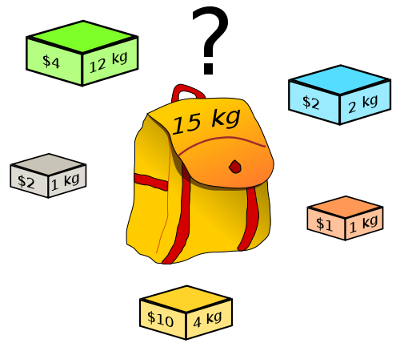
The knapsack problem
We have a set of items, each having a weight and a value.
We have a knapsack that can carry up to W amount of weight.
We want to put items in the knapsack to maximize the total value, but not exceed the weight limit.
Ex Items 3 and 4 are the highest value items with weight ≤ 11.
Assume all items have weight ≤ W, i.e. any single item fits in knapsack.
W = 11
Item
Value
Weight
1
1
1
2
6
2
3
18
5
4
22
6
5
28
7

Slide 23
A dynamic program for knapsack
Let OPT(i,v) = minimum weight of a subset of items 1,...,i that has value ≥ v.
If optimal solution uses item i.
Then we pay w_{i} weight for item i, and need to achieve value ≥ v-v_{i} using items 1,...,i-1 using min weight.
So OPT(i,v)=w_{i}+OPT(i-1,v-v_{i}).
If optimal solution doesn’t use item i.
Then we need to achieve value ≥ v using items 1,...,i-1.
So OPT(i,v)=OPT(i-1,v).
Choose the case that gives smaller weight.
OPT(i,v) = 0 if v=0
∞ if i=0, v>0
min(OPT(i-1,v), w_{i}+OPT(i-1,v-v_{i})) otherwise

Slide 24
Running time of dynamic program
Say there are n items, and the largest value of any item is v*.
The max value we can pack into the knapsack is nv*, where v* is the largest v value.
Solve all subproblems of the form OPT(i,v), where i ≤ n and v ≤ nv*.
This is a total of O(n²v*) subproblems.
The solution to Knapsack is the max value V that can be packed with weight ≤ W.
Having solved all the subproblems, we can find V by finding the subproblem with the largest value that has optimum weight ≤ W.
V = max_{v≤nv*} OPT(n,v) ≤ W.
So solving Knapsack takes total time O(n²v*).

Slide 25
Running time of dynamic program
The DP gives an optimal solution to Knapsack and takes O(n²v*) time. Have we found a polytime algorithm for an NP-complete problem?
No. The problem size is O(n log(v*)), because it takes log(v*) bits to express each item’s value. But O(n²v*) is not polynomial in n log(v*).
To make this DP fast, we have to make the largest value small.

Slide 26
PTAS
Let ε>0 be any number. We’ll give a (1+ε)- approximation for knapsack.
By setting ε sufficiently small, we can get as good an approximation as we want!
This type of algorithm is called a polynomial time approximation scheme, or PTAS.
Contrast this with earlier algs we studied, which had worse approx ratios, e.g. 2 or log n.
But the running time will be O(n³/ε). Hence we can’t set ε=0 get the optimal solution.
We’re trading accuracy for time. The more accurate (smaller ε), the more time the algorithm takes.

Slide 27
Main idea: rounding
Since we only need an approximate solution, we can change the values of the items a little (round the values) and not affect the solution much.
We scale and round the original values to make them small.
The previous DP took O(n²v*) time. So if the rounded values are small, this DP is fast.
W = 11
W = 11
Item
Value
Weight
Item
Value
Weight
1
134,221
1
1
2
1
2
656,342
2
2
7
2
3
1,810,013
5
3
19
5
4
22,217,800
6
4
223
6
5
28,343,199
7
5
284
7

Slide 28
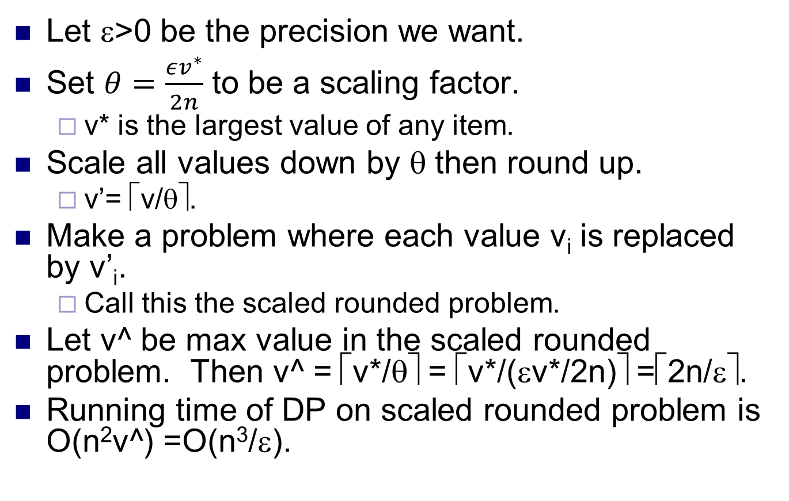
Rounding
Let ε>0 be the precision we want.
Set $θ=\frac{εv^{∗}}{2n}$ to be a scaling factor.
v* is the largest value of any item.
Scale all values down by θ then round up.
v’= ⎡v/θ⎤.
Make a problem where each value v_{i} is replaced by v’_{i}.
Call this the scaled rounded problem.
Let v^ be max value in the scaled rounded problem. Then v^ = ⎡v*/θ⎤ = ⎡v*/(εv*/2n)⎤ =⎡2n/ε⎤.
Running time of DP on scaled rounded problem is O(n²v^) =O(n³/ε).

Slide 29
Solving the original problem
Make another new problem in which each value v_{i} is replaced by u_{i} = ⎡v_{i}/θ⎤*θ.
Call this the rounded problem.
We have u_{i} ≥ v_{i}, and u_{i} ≤ v_{i}+θ.
Note u values are equal to v’ values multiplied by θ.
Thus, the optimal solution for the rounded problem and the scaled rounded problem are the same.
We now have 3 problems, the original problem, the scaled rounded problem, and the rounded problem.
Let S be the optimal solution to the scaled rounded problem, which we can find in time O(n³/ε). S is also optimal for the rounded problem.
We’ll show S is a 1+ε approximation for the original problem.

Slide 30
Correctness
Thm Let S* be the optimal solution to the original problem. Then . Hence S is a (1+ε)-approximate solution.
Proof
u_{i} ≥ v_{i}
S is opt soln for rounded problem
u_{i} ≤ v_{i}+θ
|S| ≤ n

Slide 31
Correctness
Suppose item j has the largest value, so v*=v_{j}. Then
Last inequality because item j itself is feasible solution, so opt solution S is no smaller.
So , where first inequality comes inequalities on last page.
Assuming ε ≤ 1, then
Finally, we have

Slide 32
Summary
We gave a DP for Knapsack.
We scale and round to reduce number of different item values.
Running the DP on the scaled rounded problem and using the solution for the original problem leads to an arbitrarily good approximation for Knapsack, a PTAS.
There are PTAS’s for a number of other problems.
Multiprocessor scheduling.
Bin packing.
Euclidean TSP.
However, there are also many problems for which PTAS’s do not exist, unless P=NP.

